Slide 1
Conor Farrell Weekly Progress
06/02/26

Slide 2
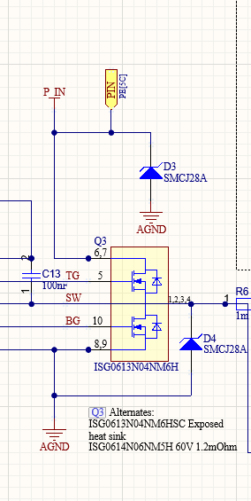
Power Electronics Bring Up
Problem On power up, board went to constant current ~0.8V, 250mA(current limit)
Investigation
Checked hotspots with thermal camera. Saw U9 (Soft Start Gate Driver) was heating up.
Desoldered IC and the issue still appeared.
Checked Diode drop across TVS diodes (D3, D4) with multimeter. P_in -> AGND had a 0.6V drop, AGND->P_in was open circuit.
Solution
D3 and D4 desoldered and reorientated.

Slide 3
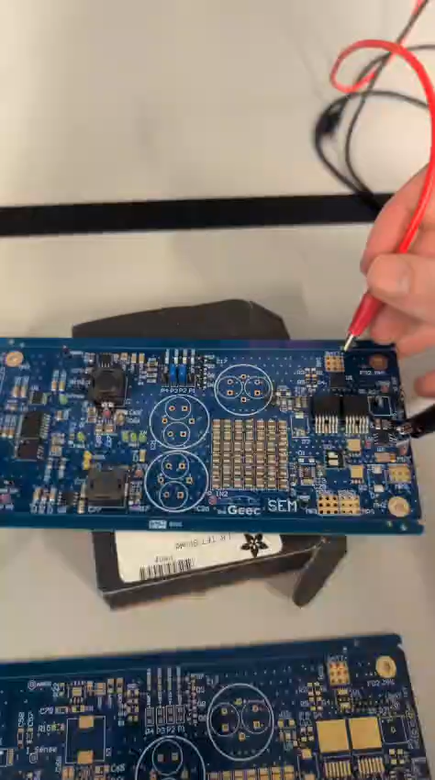
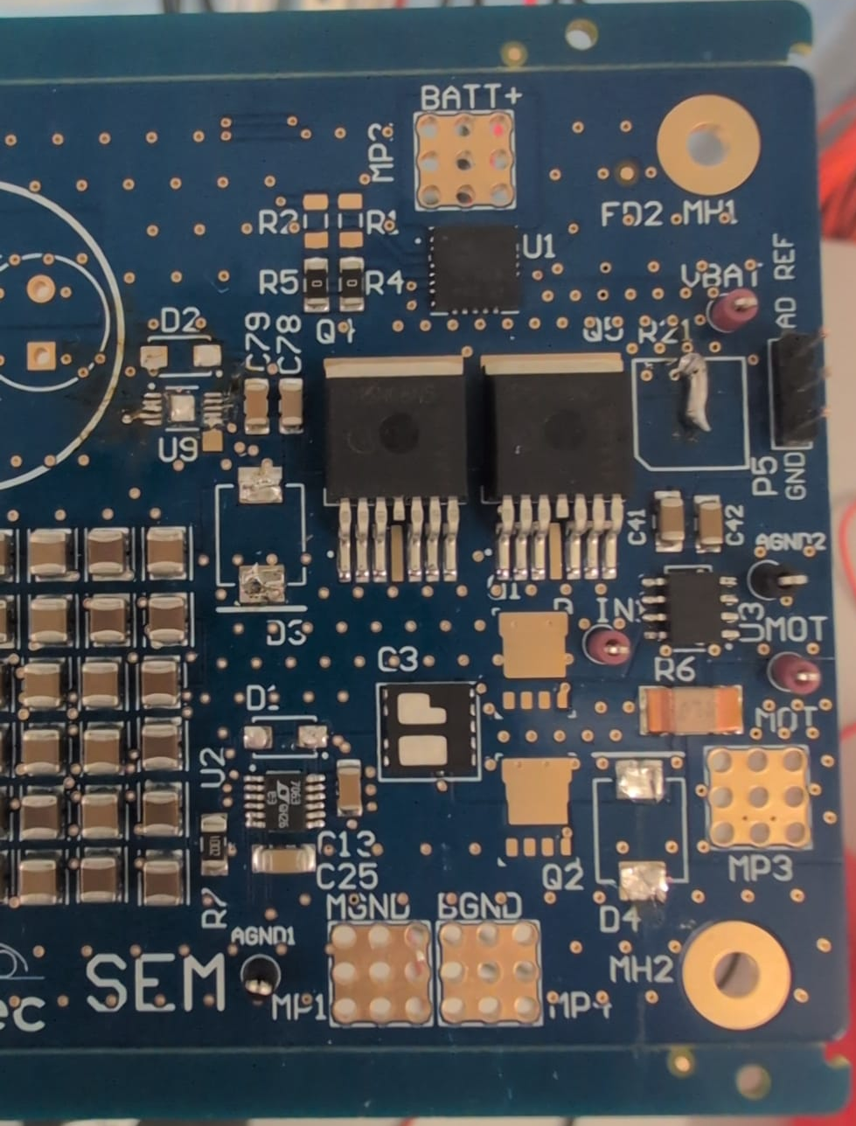
LED Turn On
Power Rail LEDs:
Red LEDs indicate 3.3V and 11V rails
Power Supply drew 2mA on power up (with LEDs disconnected) @ 18V
Damage:
1 board missing U9 soft start IC. Shorted Soft Start resistor. Will use for testing as a sacrificial board.

Slide 4
Power Controller
Circuit Design
Altium Schematic Started, all components imported.

Slide 5
Goal for Next Week
Track Test – (Monday) - No goals beside running the car well
Test Gate Drivers – Tuesday – No load Testing
Test Current Sensors – Thursday Morning – Minimum 2A load required
Build Current Controller on Breadboard – Tuesday, Wednesday, Thursday
Schematic Design – Finished End of Next Week

